Slide 1
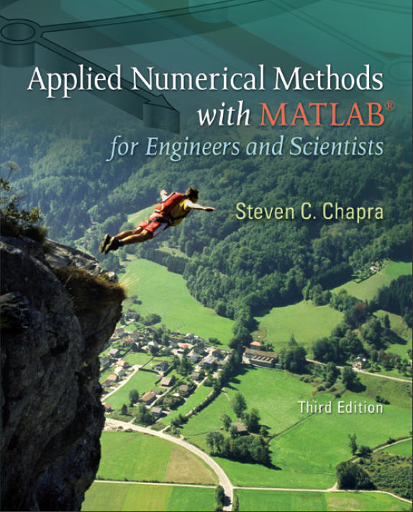
Part 6
Chapter 22
Initial-Value Problems
PowerPoints organized by Dr. Michael R. Gustafson II, Duke University
All images copyright © The McGraw-Hill Companies, Inc. Permission required for reproduction or display.

Slide 2
Chapter Objectives
Understanding the meaning of local and global truncation errors and their relationship to step size for one-step methods for solving ODEs.
Knowing how to implement the following Runge-Kutta (RK) methods for a single ODE:
  Euler
  Heun
  Midpoint
  Fourth-Order RK
Knowing how to iterate the corrector of Heun’s method.
Knowing how to implement the following Runge-Kutta methods for systems of ODEs:
  Euler
  Fourth-order RK

Slide 3
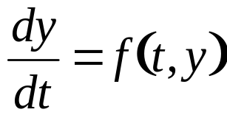

Ordinary Differential Equations
Methods described here are for solving differential equations of the form:
The methods in this chapter are all one-step methods and have the general format:
where φ is called an increment function, and is used to extrapolate from an old value y_{i} to a new value y_{i+1}.

Slide 4
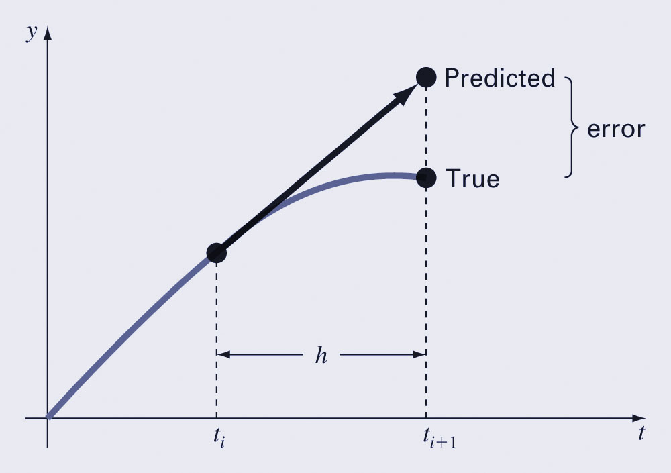
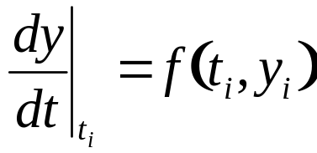
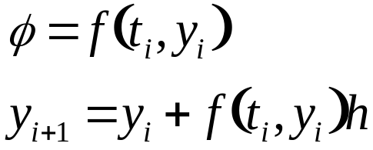
Euler’s Method
The first derivative provides a direct estimate of the slope at t_{i}:
and the Euler method uses that estimate as the increment function:

Slide 5
Error Analysis for Euler’s Method
The numerical solution of ODEs involves two types of error:
  Truncation errors, caused by the nature of the techniques employed
  Roundoff errors, caused by the limited numbers of significant digits that can be retained
The total, or global truncation error can be further split into:
  local truncation error that results from an application method in question over a single step, and
  propagated truncation error that results from the approximations produced during previous steps.

Slide 6
Error Analysis for Euler’s Method
The local truncation error for Euler’s method is O(h²) and proportional to the derivative of f(t,y) while the global truncation error is O(h).
This means:
  The global error can be reduced by decreasing the step size, and
  Euler’s method will provide error-free predictions if the underlying function is linear.
Euler’s method is conditionally stable, depending on the size of h.

Slide 7
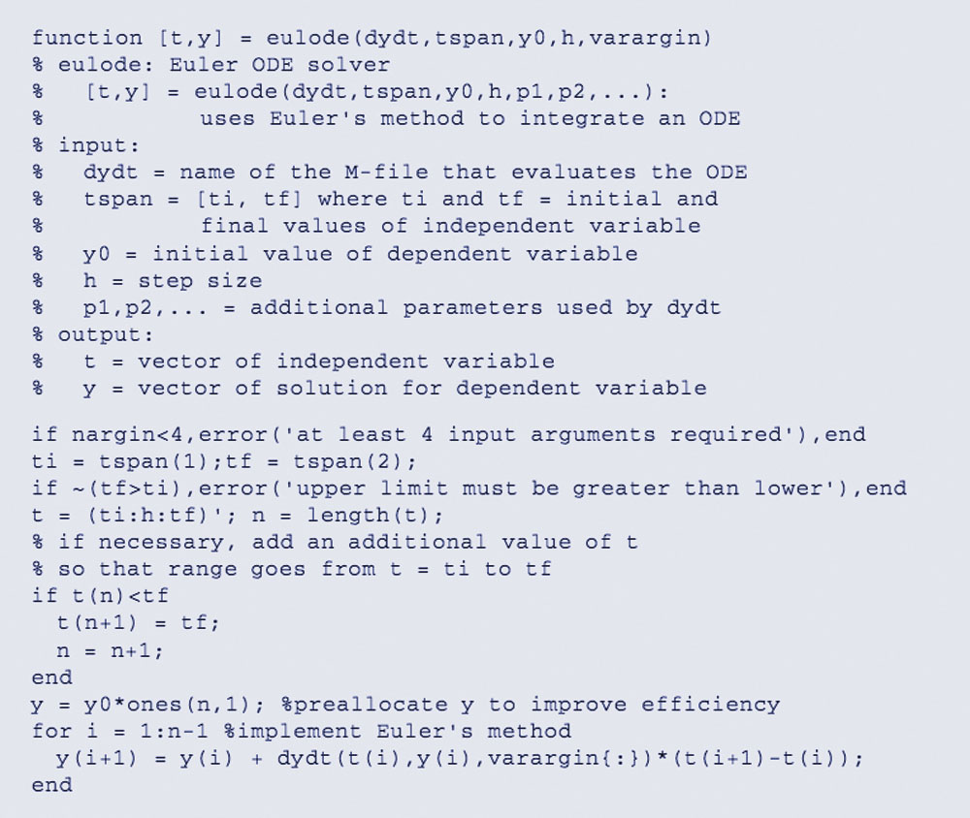
MATLAB Code for Euler’s Method

Slide 8
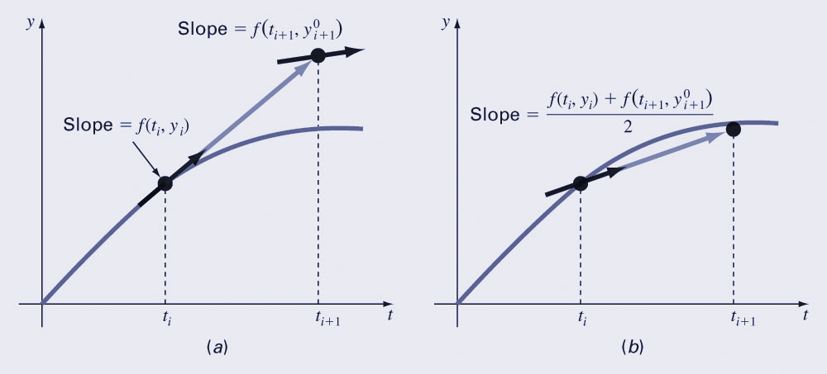
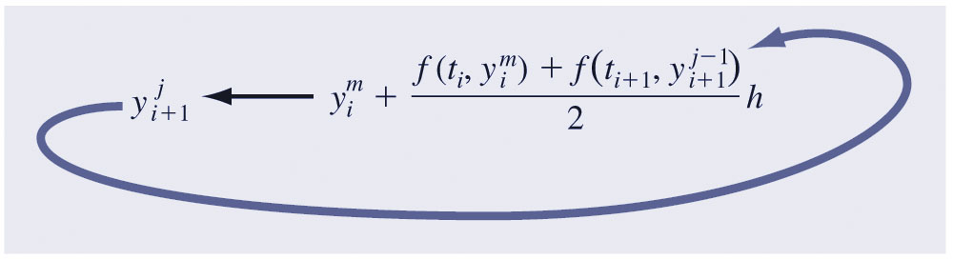
Heun’s Method
One method to improve Euler’s method is to determine derivatives at the beginning and predicted ending of the interval and average them:
This process relies on making a prediction of the new value of y, then correcting it based on the slope calculated at that new value.
This predictor-corrector approach can be iterated to convergence:

Slide 9
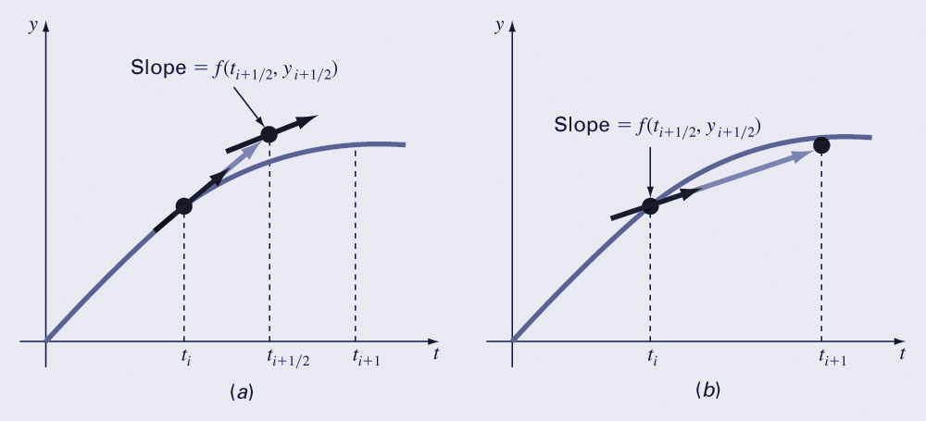
Midpoint Method
Another improvement to Euler’s method is similar to Heun’s method, but predicts the slope at the midpoint of an interval rather than at the end:
This method has a local truncation error of O(h³) and global error of O(h²)

Slide 10

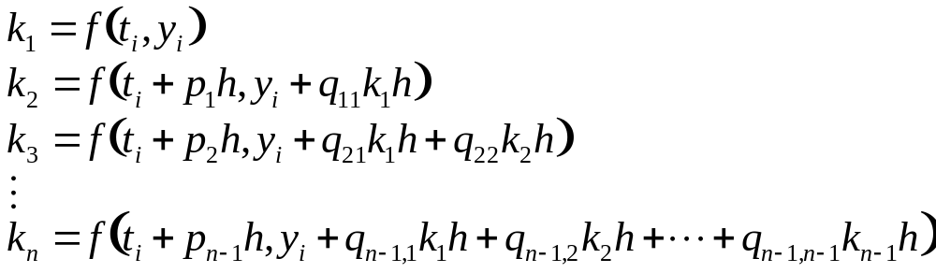
Runge-Kutta Methods
Runge-Kutta (RK) methods achieve the accuracy of a Taylor series approach without requiring the calculation of higher derivatives.
For RK methods, the increment function φ can be generally written as:
where the a’s are constants and the k’s are
where the p’s and q’s are constants.

Slide 11
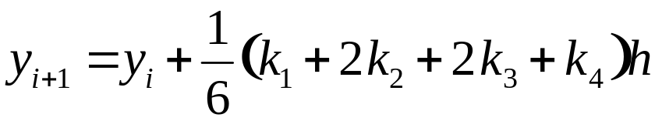
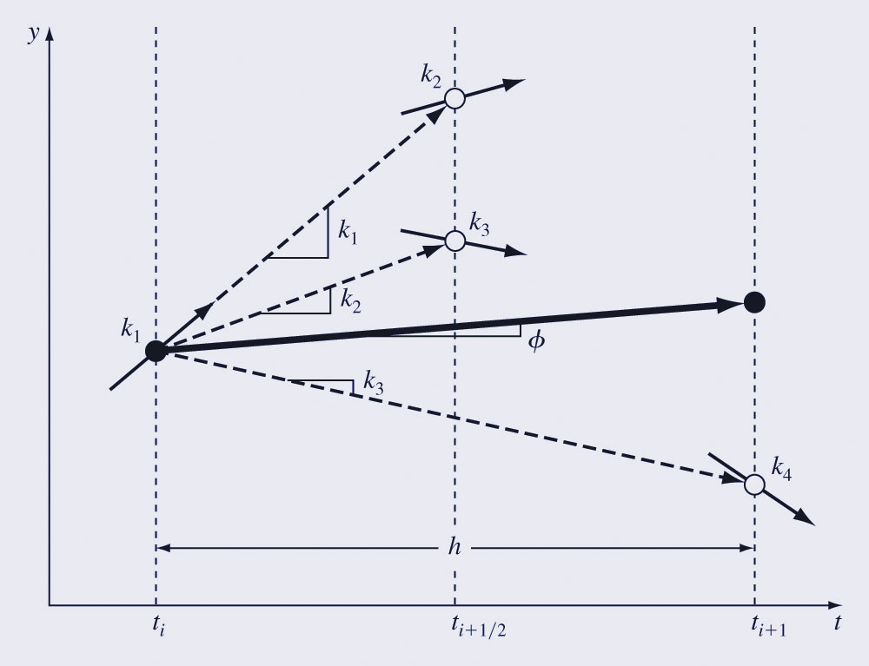
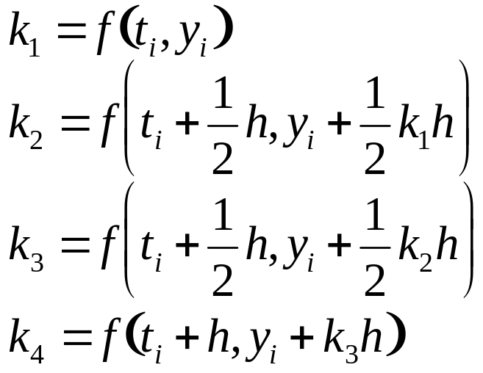
Classical Fourth-Order Runge-Kutta Method
The most popular RK methods are fourth-order, and the most commonly used form is:
where:

Slide 12
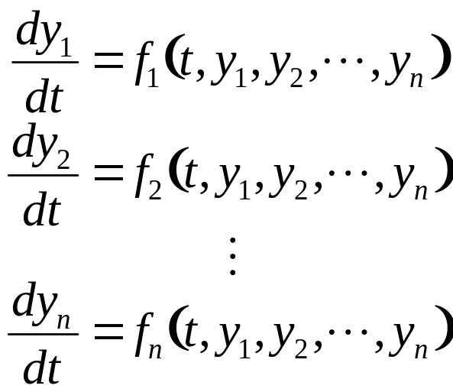
Systems of Equations
Many practical problems require the solution of a system of equations:
The solution of such a system requires that n initial conditions be known at the starting value of t.

Slide 13
Solution Methods
Single-equation methods can be used to solve systems of ODE’s as well; for example, Euler’s method can be used on systems of equations - the one-step method is applied for every equation at each step before proceeding to the next step.
Fourth-order Runge-Kutta methods can also be used, but care must be taken in calculating the k’s.

Slide 14
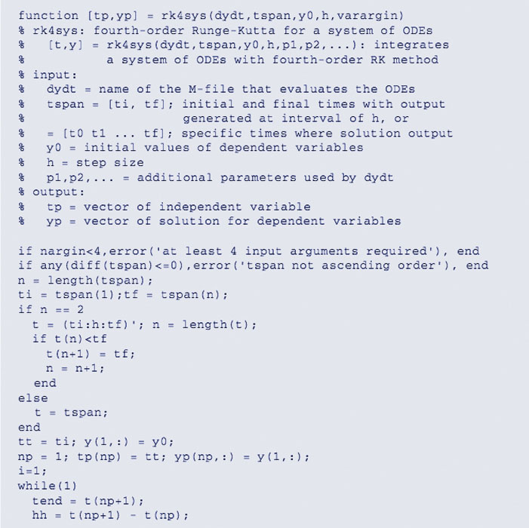
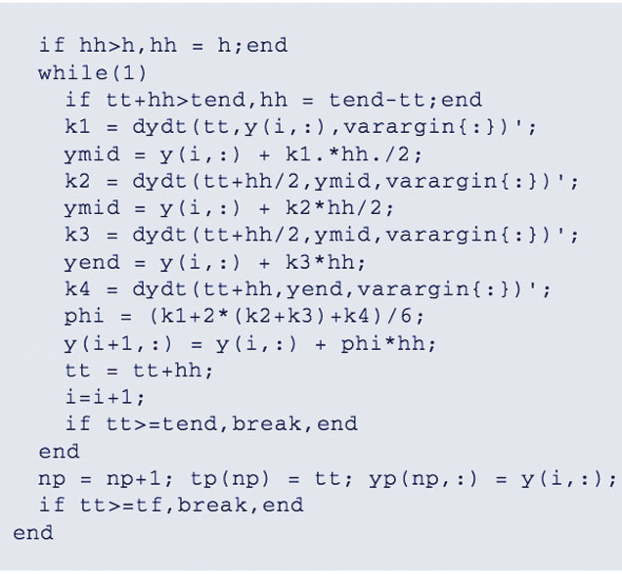
MATLAB RK4 Code

